Slide 1




Master in Management
FINANCIAL AND ESG REPORTING
Class 4
Fall, 2025

Slide 2

Objective of this class:
Sustainability reporting assurance
ESG KPIs
ESG investment and principles for responsible investment
ESG-scores, ratings and ranking lists
2

Slide 3
Sustainability reporting assurance
3

Slide 4
Why we need sustainability assurance?
Growing importance of sustainability reports
Because of the usefulness of sustainability reports, stakeholders, have demanded transparency and questioned the reliability of sustainability reporting
Possibility of greenwashing: Low ESG commitment firms may use ESG reports to “green-wash”/“social-wash” with selective and less verifiable CSR disclosure to manage stakeholder perceptions and to enhance legitimacy
Stakeholders’ demand:
Improve credibility
Firms’ response:
Provide assurance of ESG reporting

Slide 5
What is sustainability assurance?
‘External assurance or verification can provide both report readers and internal managers with increased confidence in the quality of sustainability performance data, making it more likely that the data will be relied on and used for decision making’ (GRI, 2013).
Main goal: improve the credibility of sustainability reporting

Slide 6
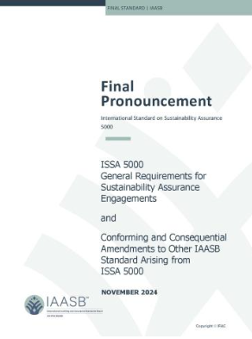
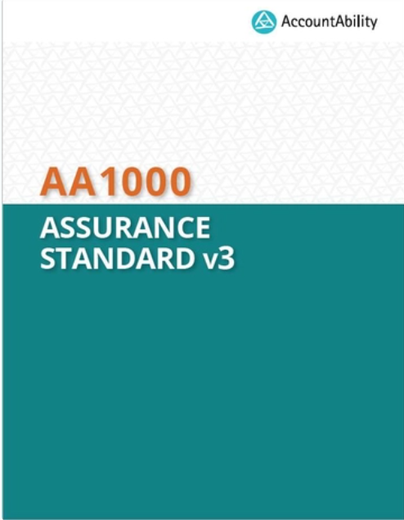
Assurance standards
Specific guidance on sustainability report assurance is lacking, but there are currently two standards that provide guidance on assurance engagements in general:
International Standard on Sustainability Assurance (ISSA) 5000, International Audit Assurance Standards Board (IAASB)
AA1000 Assurance Standard (AA1000AS), AccountAbility (a UK-based consultancy firm)
Notes:
The International Auditing and Assurance Standards Board (IAASB) has published two new resources to support the adoption and implementation of its International Standard on Sustainability Assurance (ISSA) 5000 General Requirements for Sustainability Assurance Engagements. The first resource includes reference extracts containing only the material in ISSA 5000 that is relevant to limited assurance engagements, and separately, reasonable assurance engagements. The second resource contains frequently asked questions that clarify for jurisdictions that adopt the IAASB standards that the International Standards on Assurance Engagements (ISAE) 3000 (revised) and 3410 will no longer apply for sustainability assurance engagements once ISSA 5000 is effective in December 2026. Please click to access the resources via the press release on the IAASB website.

Slide 7
Assurance standards
International Standard on Sustainability Assurance (ISSA 5000)
More closely related to the accuracy of disclosed information
Effective in December 2026
Previously: International Standard on Assurance Engagements (ISAE 3000)
More specific and targeted requirements for performing sustainability assurance engagements
AA1000 Assurance Standard (AA1000AS)
Originally issued in 2008.
The latest update, v3, was published in 2020.
The assurance provider evaluates the nature and extent of the organisation’s adherence to four AA1000 AccountAbility Principles, inclusivity, materiality, responsiveness and impact.
The aim is to provide stakeholders information on how the organisation in focus manages its sustainability performance and how this is communicated in the sustainability reporting.
Notes:
5000 v 3000: https://assets.kpmg.com/content/dam/kpmg/cn/pdf/en/2025/05/enhanced-sustainability-assurance.pdf#page=6.99
5000 v 1000: https://www.linkedin.com/pulse/assurance-standards-sustainability-aa1000as-v3-vs-issa-hiremath-f1doc/
ISAE3000 is more closely related to the financial accounting and auditing practices. It was established by IFAC, which is the international body issuing accounting and auditing standards. The first version was issued in 2003, with a subsequent revision in 2013. While the scope of ISAE3000 is not only about sustainability reporting, as it includes various kinds of assurance engagements other than audits or reviews of historical financial information, it is relevant in the context of sustainability accounting as it is used by accounting firms in their efforts to provide assurance for sustainability disclosures.
Principle Definition
Inclusivity People should have a say in the decisions that impact them
Materiality Decision-makers should identify and be clear about the sustainability topics that matter
Responsiveness Organisations should act transparently on material sustainability topics and their related impacts
Impact Organisations should monitor, measure and be accountable for how their actions affect their broader ecosystems

Slide 8
Sustainability assurance vs financial audit
Will be mentioned later
 | Legal status | Subject matter | Service provider | Level of assurance provided
Financial statement audit | Mandatory | General purpose financial report | Registered auditor, accounting professional | Reasonable
Sustainability assurance | Mandatory or voluntary | Comprehensive CSR reports, or a specific subject matter area (e.g. greenhouse gas emission) | Professional accountants, Consultants, Internal auditors (no required to be an accounting professional) | Limited or reasonable
Notes:
One question you may be interested in is how CSR assurance differs from the financial statement audit you have been learning about over the past few weeks. The table in this slide briefly summarize some diffs First, about the legal status, financial auditing is required, whereas firms can choose whether to conduct CSR assurance or not. Second, financial auditing and CSR assurance have diff sub matters Generally speaking, Sub matter the area being audited/assured. Financial statement audit mainly focuses on the General purpose financial report. However, CSRA has a variety of sub matters. The sub matter could be Comprehensive CSR reports, or a specific subject matter area, such as greenhouse gas emission. For a comprehensive report, part of the challenge for the assurance provider is to ensure that all sig issues that fall under the broad categories are appropriately reported (in other words, no greenwashing or cherry-picking of sig topics) and need to ensure that information is reported in accordance with the reporting criteria. That would be a heavy workload. The service providers of fin auditing and CSRA are diff as well. People expect Registered auditors from audit firms to review financial statements because they tend to have professional knowledge and skills of accounting. However, CSRA does not require a registered auditor. Professional accountants from the Audit firm is only one option, firms can also choose to hire Consults or even Internal auditors as the assurance providers. As for the assurance level, financial auditing requires a reasonable level, whereas, for CSRA, either a reasonable assurance or a limited assurance could be chosen. So firms have more choices. More details about CSR assurance providers and levels will be introduced in the next two slides.

Slide 9



Sustainability assurance providers
Professional accountants
Big-four and other professional audit firms
Independent, highly reputable experts
Guaranteeing high quality of the assurance procedures
External CSR consultants
Possess significant expertise in the subject matter
May not have standards of professional conduct, procedures, reporting and independence
Internal auditors
Access to internal information
Management role
Lack of independence, may impair the quality of CSRA engagements
Notes:
In view of the choice of service provider, the domain of CSRA includes the participation of three distinct groups of people: professional accountants including big-four and other professional audit firms, external CSR consultants, and internal auditors. Professional accountants, especially big-four audit firms, are independent, highly reputable experts, and are expected to guarantee the high quality of their assurance procedures. People appreciate audit firms, especially big 4 because firm size is a key measure of stakeholders’ perceptions of auditor independence and thus of audit quality. People believe that big4 audit firms have more resources, industry specialization, and international reputation. These features promote the quality of professional auditors’ work, which makes them important contributors to increasing stakeholders’ awareness of CSRA. However, auditors may lack subject expertise, such as some assurance knowledge about environmental or social issues. in these cases, assurance standards outline the process for the involvement of individual experts to assist during CSRA engagements. The cost associated with this comprehensive quality is manifest in high fees. In order to reduce these fees, firms are likely to engage external CSR consultants to provide assurance. These individuals possess significant expertise in the subject matter, but they may not have the same standards of professional conduct, procedures, reporting and independence as auditors. The last option is internal auditors, who work within the firm. An internal auditor (IA) is a trained professional tasked with providing independent and objective evaluations of company financial and operational business activities. They are employed to ensure that companies follow proper procedures and function efficiently. Internal auditors can be an important source of assurance services within a firm’s corporate governance system. Assurance of CSR reports is predicted to be one of the most significantly increasing activities of internal auditors in the near future. Internal auditors represent an appealing alternative to external CSRA providers because of their access to management reporting structures, their supporting role as a management instrument is an added value for the company. But we should also admit that the biggest shortcoming of IA as assurance providers is that IA may lack independence and this may impair the quality of CSRA engagements.

Slide 10
Sustainability assurance levels
Reasonable assurance
Limited assurance
high level of assurance, but not absolute level of assurance due to limitations of the internal control system and of the assurance process itself.
provided through a statement in the positive form on the accountability matter where the practitioner reports that ‘the information in the environmental and social report conforms in all material respects with the identified criteria’ .
a more moderate or limited level of assurance.
the accompanying assurance statement is worded in the negative form, where the practitioner reports that ‘nothing has come to their attention to indicate that the information is not presented fairly in accordance with the identified criteria’.
Notes:
Unlike fin auditing, Assurance standards provide enterprises with the opportunity to choose the level of assurance. Firms are free to choose to assure at a reasonable level or limited level. Therefore, we need to understand the differences between reasonable assurance and limited assurance. Compared to limited assurance, reasonable assurance is a high level of assurance, but we should be aware that due to limitations of the internal control system and of the assurance process itself, reasonable assurance is not equal to absolute assurance. Reasonable assurance is usually worded in a positive form. For example, in the assurnac statement, service providers may conclude that ‘the information in the environmental and social report conforms in all material respects with the identified criteria’. In contrast, lim assurance means to assure at a moderate or limited level. Assurance statement is usually worded in the negative form, like ‘nothing has come to their attention to indicate that the information is not presented fairly in accordance with the identified criteria’.

Slide 11
Sustainability assurance development in EU
CSRD (Corporate Sustainability Reporting Directive)
The CSRD would include a mandatory assurance obligation for all reported sustainability information, including the disclosures required under the EU Taxonomy Regulation.
The CSRD requirements begin with limited assurance and expand to reasonable assurance at a later date.
Omnibus (2025): keep the assurance requirement at the level of “limited” assurance, not moving in the future to the more demanding level of “reasonable” assurance
Jan 2024 | First tier of companies starts CSRD sustainability reporting
Sep 2024 | The IAASB approves International Standard on Sustainability Assurance 5000 (ISSA 5000)
Oct 2026 | The European Commission is expected to adopt limited assurance standards
Dec 2026 | The ISSA 5000 standards become effective
Oct 2028 | Adoption of the reasonable assurance standards (depending on feasibility study)
Notes:
The European Commission is set to adopt limited assurance standards by 1 October 2026 to clarify what is expected from the limited assurance engagement regarding the information reported according to the ESRS. As of today, there are no EU-wide standards, but the CSRD requires assurance from its initial reporting year. The European Commission will likely adopt the International Standard on Sustainability Assurance 5000 (ISSA 5000), the standards created by the International Auditing and Assurance Standards Board (IAASB). This approach is logical as the EU-wide limited assurance standards, after appropriate amendments, reflect the requirements of the CSRD. The ISSA 5000 were approved in September 2024 and the standards will be effective by 15th December 2026.
Proposed ISSA 5000 is principles-based and addresses:
Both limited assurance and reasonable assurance;
The conduct of an assurance engagement in its entirety; and
Areas of sustainability assurance engagements where priority challenges have been identified, and more specificity is required.

Slide 12
Special nature of sustainability assurance
The existence of a competitive market
Different types of providers
2. The diversity of the subject matter examined
Different types of subject matters and forms of information
3. The lack of analytic rigor that arises in double-entry systems
Risk of material misstatement
4. The relative lack of well-developed criteria
Appropriate assurance techniques and approaches?
Notes:
This slide aims to summarize some unique features of CSRA. First, the CSR assurance market is very competitive. It is a market in which the accounting profession does not have a monopoly. Firms have the freedom to choose assurance services from different providers. So firms balance the benefits and costs and choose the most efficient assurance provider. Next, CSR assurance covers diverse Subject Matters. Here, the diversity is not only expressed in content, but also in form. Assurance of general CSR reports involves the examination of very diverse subject matters, including envi, social and economic factors. Meanwhile, As we can see from the range of subject matters reported under GRI G4, these are not necessarily measured in any type of common currency, such as the feelings of customers. The aim of CSR reports is not to monetize all these resources and relationships, but rather to report them so that the report user has the information on which to make his/her decision. Thus, it may be that some of the reporting areas are capable of being monetized, others of being quantified, and others of only being described. Therefore, CSRA providers need to review both quantitative and qualitative CSR information. This is different from auditing, which mostly looks at accounting numbers. Thirdly, we know that The financial reporting framework has the advantages associated with double-entry accounting when you debit something, you must also credit something. The mathematical and systems rigor associated with financial accounting helps auditors detect any misstatements or omissions in the job. However, Most of the issues involved in CSR reporting do not have a double-entry system. This can result in different types of risk of material misstatement and may bring challenges to CSRA providers. Last but not least, CSRA lacks Well-Developed Criteria As compared to financial reporting criteria, CSR reporting criteria are less well developed. Not all aspects of CSR are currently capable of being quantified, much less monetized. Thus, the assurer has to have appropriate assurance techniques over not only monetized information but also both quantitative and qualitative information. Approaches The assurance approaches are similar to financial auditing, which involves (1) gaining an understanding of the entity, (2) undertaking a risk assessment, and then (3) responding to assessed risks by employing the most efficient and effective combination of tests of control and substantive testing. These steps, of course, need to be customized to the subject matter. Because of the lack of Well-Developed assurance Criteria, and because of the complexity of CSR information, During the assurance approaches, there are some challenges for assurers. For instance, As CSR report contains a variety of information, multidisciplinary, the assurance teams are commonly multidisciplinary. Then one challenge is how to best bring multidisciplinary groups together? In addition, techniques of identifying risks of material misstatement of diverse CSR issues may also be different, and assurers need to establish appropriate methods used for different envir, social and eco indicators. Materiality Second, assurers may also face the challenge when determining materiality. We know that materiality measures the importance of assured information, and it affects the assurance quality directly. For CSR indicators, there is no common unit of measurement, (for example, when the report contains financial, workplace safety, emissions, and intellectual capital information). So how materiality is determined for a CSR report assurance engagement is a big challenge. Thirdly, the diverse indicators and mixed forms of CSR reports increase the difficulties of identifying misstatements and frauds. The fourth challenge may happen in the process of evidence collection. For example, when assurers review envi or social information, how do they verify that information is free from material misstatement and omissions? As we discussed, there is no double-entry system for them to rely on. Also, given that a lot of narrative- and future-oriented information is commonly included in CSR reports, so one challenge would be, how do assurance providers evaluate the veracity of such information. In the last stage, assurers need to prepare the assurance statement and show the results. As firms have the freedom to choose assurance levels, assurers need to communicate with the management and decide on appropriate assurance levels beforehand. Also, given that there is a lack of specific CSRA guidance, assurance providers need to ensure that their reports are professional, understandable and readable.

Slide 13
Some examples…
Let’s look at some examples from different companies.
What are the similarities and differences among them?
The report format
Subject matter (specific reports/comprehensive CSR reports)
Assurance provider
Assurance level

Slide 14
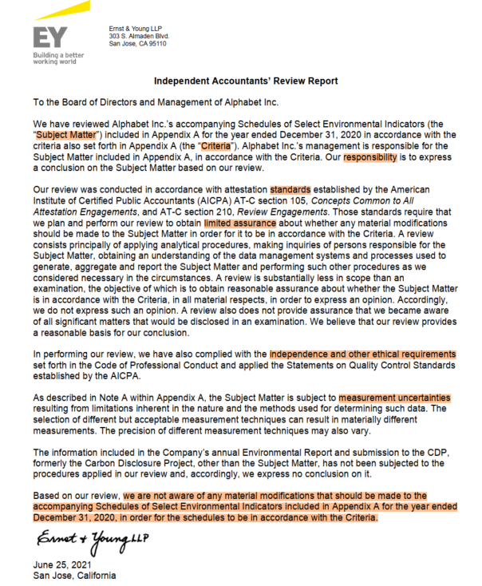
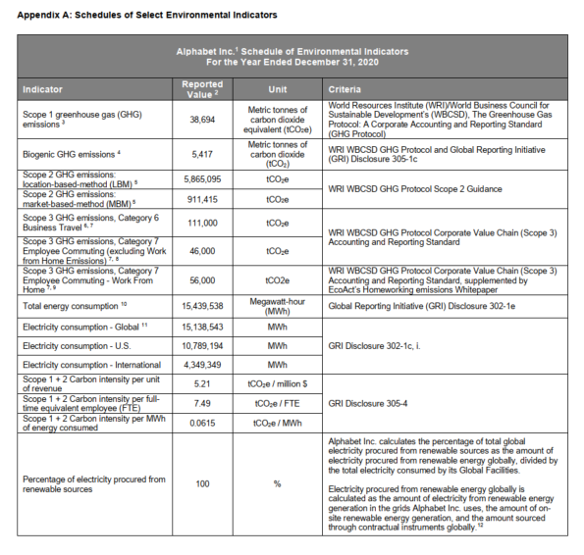
Subject matter
Responsibility
Standards
Assurance level
Conclusion
Alphabet 2020 Environmental indicators assurance letter

Slide 15
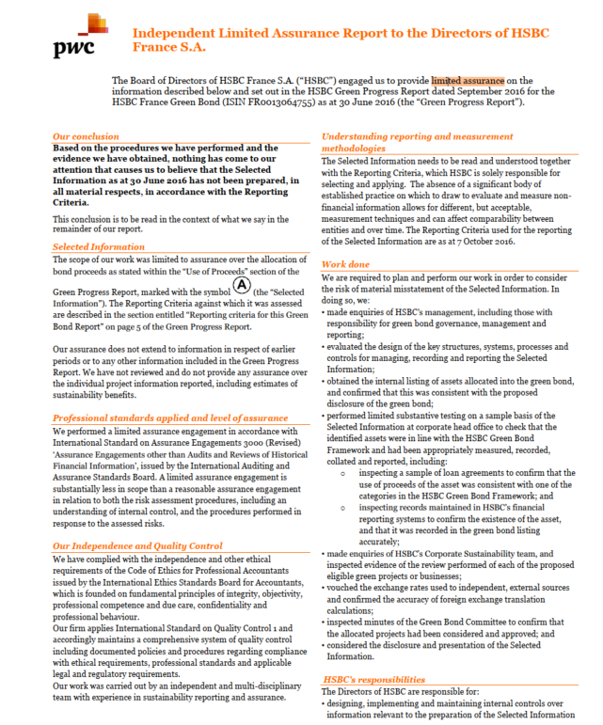
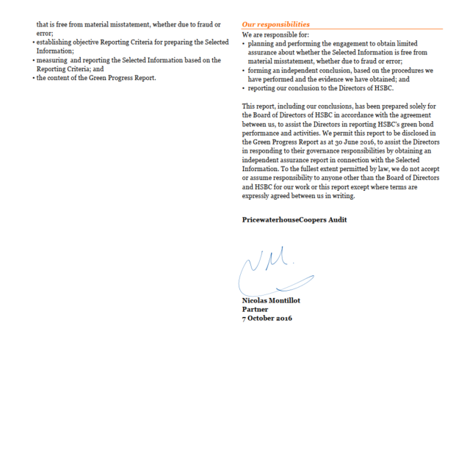
Big-four
Different structure
Independent Limited Assurance Report to the Directors of HSBC 2016

Slide 16
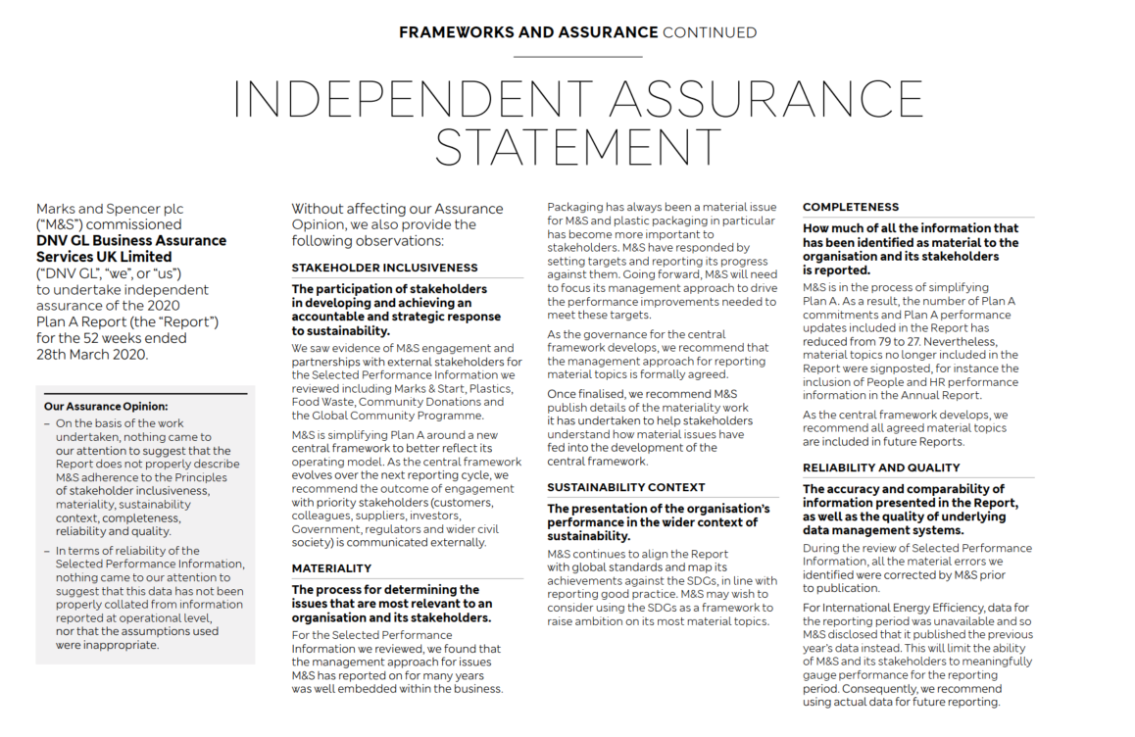
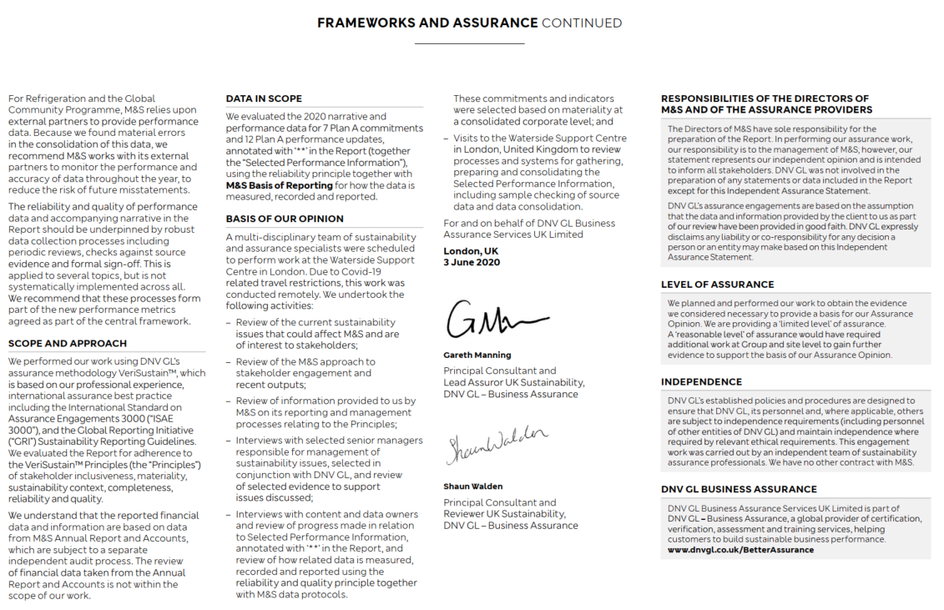
Subject matter: economic, social and environmental information
Non-big-four
INDEPENDENT ASSURANCE STATEMENT for M&S Plan A report 2020

Slide 17
Sustainability assurance issues and challenges
Can sustainability assurance ensure the credibility of sustainability reporting?
Firms usually produce voluntarily and which have often shown to be emphasising positive things at the expense of more negative and challenging topics
Whether and to what extent the assurance providers aid in ensuring the reliability of the reported information, or whether an assurance statement tells us if the most pertinent issues have been covered in a report.
The scope of the assurance engagements
It is up to the reporting firm to decide the scope of the engagement
In most cases, the assurance is limited to a relatively minor part of the report
A casual reader can easily be left with an impression that the whole report would have been subject to an assurance process, and that the level of said assurance would have been similar to that used in the financial auditing function.
Notes:
Even though assurance practices have developed over time, the phenomenon is not without challenges. It is worth bearing in mind that neither sustainability reporting nor assurance practices are exercised within a strong legally binding framework. In general terms, the underlying idea of assurance relates to enhancing the credibility and reliability of the sustainability disclosures, which firms usually produce voluntarily and which have often shown to be emphasising positive things at the expense of more negative and challenging topics. Now, it is worth asking, for instance, whether and to what extent the assurance providers aid in ensuring the reliability of the reported information, or whether an assurance statement tells us if the most pertinent issues have been covered in a report. In other words, in this context there is a major difference between asking “Are these numbers right?” and “Are these the right numbers?” The challenge here is that a positive assurance statement given by, say, a major global Big4 accountancy firm, has substantial symbolic power, as it can signal credibility and indicate trustworthiness.
One of the key challenges relates to the scope of the assurance engagements. As assurance is not regulated, it is up to the reporting firm to decide the scope of the engagement – that is which parts of the report or reporting process will be subject to assurance. In most cases, the assurance is limited to a relatively minor part of the report, implying that in some accounting type engagements the assurors might only have looked more closely into a particular topic area and the information provided therein. Still, a casual reader can easily be left with an impression that the whole report would have been subject to an assurance process, and that the level of said assurance would have been similar to that used in the financial auditing function.
Being under the discretion of the reporting firm’s management entails another issue, the assurance provider’s independence. While the financial auditors are in principle serving the firm’s shareholders, the owners, the sustainability assurance providers are primarily responsible to the senior executives of the firm. That is, the firm’s senior executives can outline the scope and the characteristics of the task. Moreover, should the assurance providers come up with a negative report, it could be considered possible that the firm’s senior executives would no longer turn to the same providers next year.

Slide 18
Sustainability assurance issues and challenges
Assurance provider’s independence
The sustainability assurance providers are primarily responsible to the senior executives of the firm
Should the assurance providers come up with a negative report, it could be considered possible that the firm’s senior executives would no longer turn to the same providers next year
Also provide sustainability consultation service?
Notes:
Being under the discretion of the reporting firm’s management entails another issue, the assurance provider’s independence. While the financial auditors are in principle serving the firm’s shareholders, the owners, the sustainability assurance providers are primarily responsible to the senior executives of the firm. That is, the firm’s senior executives can outline the scope and the characteristics of the task. Moreover, should the assurance providers come up with a negative report, it could be considered possible that the firm’s senior executives would no longer turn to the same providers next year.
或者和financial auditing一个公司？打折？或者consultant—不会否定自己的工作

Slide 19
Decisions on sustainability assurance
Decisions on sustainability assurance include:
1. Implement sustainability assurance or not?
2. What kind of assurance provider to choose?
3. What level of assurance to choose?
If you were a manager, what would you expect from a sustainability assurance?
→ Compare benefits and costs

Slide 20
Some research findings-Decisions on sustainability assurance
Benefits:
Costs:
Notes:
Question the independence and process of CSRA
Question the professionality of assurance providers
Lack of specific guidance
Limited assurance

Slide 21
Some research findings-Real improvement or misplaced confidence?
Does CSRA really improve the credibility? Or the benefits are solely attributable to increased, but perhaps misplaced confidence? (mixed evidence)
Some studies fail to find evidence to support CSRA to enhance credibility (e.g., Cho et al., 2014; Christensen, 2016)
The effect of CSRA may depend on the institutional context, such as legal environment (Du and Wu, 2019).
The effect of CSRA may depend on the stage of development (Peters and Romi, 2015).

Slide 22
ESG metrics and KPIs
22

Slide 23
Key Performance Indicators (KPIs) for ESG
KPIs refer to some measurable values which tell us how an organisation is performing against particular objectives, or indicators, set in advance.
Quantitative and qualitative
KPIs are a common way in organisations to assess how targets are being reached on multiple levels.
KPIs for ESG…
help managers to integrate non-ﬁnancial aspects of performance into their decision making and ensure long-term viability of their companies
help investors integrate ESG into their investment process and maximizes their long-term interest…
Notes:
For information to have an influence in organisational decision-making it needs to be embedded into the processes through which performance is evaluated and goals for actions are set. One mechanism for this is integrating sustainability into key performance indicators (KPIs).
There is no one right way for an organisation to set their KPIs. As is the case with traditional KPIs focusing on financial performance, the same metrics cannot be directly applied for all individuals, units or organisations. At the same time, it is well established that metrics such as KPIs affect the behaviour of individuals and groups. We can for instance try harder in order to achieve higher performance on a given KPI, and particularly so when incentives are set for such achievements. KPIs can be effective in steering an organisation in a particular direction and therefore provide opportunities to integrate sustainability considerations into decision-making across multiple organisational levels. However, focusing on performance alone does not necessarily suffice, and hence other types of controls, such as planning controls concerning budgets, objectives and resources, as well as administrative controls consisting of organisational structures and policies, also need to be considered.
It should be underscored that even if some sustainability information is readily available or easy to collect, it is not necessarily useful for decision-making. Consider raising environmental awareness in an organisation for instance. If a KPI is set to measure the number of people attending a training event, the unit responsible for the training has an incentive to organise multiple training events. Such a KPI however tells us little about whether the training had resulted in a higher environmental awareness.

Slide 24
What are ESG KPIs based on?
Sustainability strategy, goals
Materiality assessment and stakeholder expectations
ESG reporting frameworks and standards (GRI, SASB, TCFD…)
Industry-specific considerations and peer benchmarking
Notes:
ESG KPIs are based on an organization’s sustainability strategy, goals, and material topics. ESG reporting frameworks and standards may also serve as helpful guides.
Disclosure and reporting frameworks often have their own set of standards, which many organizations incorporate into their own ESG data tracking. These standards often vary by sector and industry, giving reporting organizations specific guidelines to meet.
For example, the Sustainability Accounting Standards Board (SASB) is a great place to start for many organizations. The SASB Standards identify ESG issues material to dozens of industries, and SASB’s guidance includes recommended accounting and metrics for each sector. Global disclosure system CDP also incorporates industry-specific questions into its annual questionnaires. Another industry-specific example is the European Public Real Estate Association’s (EPRA) Sustainability Best Practices Recommendations, which provide guidelines for measuring sustainability performance for listed real estate companies.

Slide 25
What makes a good ESG KPI?
Consistent
Operational/measurable
Align with the purpose
Relevant: useful for decision making
- Environmental awareness in an organisation
- KPI: the number of people attending a training event
- Is this a good KPI?
Achievable but ambitious
Time-bound
Notes:
Consistency is key. Calculation methods should be consistent from year to year in order to ensure accuracy and clarity in your data tracking. The criteria for a KPI having been met should also be consistent from year to year.
Another key point to keep in mind is “purpose.” Why are you tracking ESG metrics? Ultimately, KPIs should provide context to shareholders and investors. They should help you tell your story and communicate the aims of your organization.
Indicators should be either quantitatively measurable or be operationally used to represent a value qualitatively”. This property makes sure that only measurable, whether quantitatively or qualitatively, indicators are qualiﬁed as SIs
What do your ESG KPIs say about your organization’s due diligence, risk management, and awareness? How do they demonstrate your commitment to ESG, progress towards goals, and overall resilience?
Instead:
知识测试或问卷调查结果：
通过对培训前后进行环境意识测试或问卷调查，衡量员工的环境知识提升情况。例如，测试员工对碳排放、能源效率、废物管理等主题的理解。
KPI 可以是培训前后测试成绩的提升幅度，这可以更直接反映培训的实际效果。
Qualitative: 比如认证
衡量这些定性指标的方法可以包括政策文件的审查、利益相关者的反馈、访谈和案例研究。
顾客满意度：survey ABCD…
Time-Bound
Good ESG KPIs include a time frame for achieving the targets, ensuring that progress can be monitored and evaluated within a specific period. Time-bound KPIs drive accountability and prevent indefinite goals.
Example: "Achieve carbon neutrality by 2030" sets a clear deadline, unlike a more vague goal such as "reduce carbon emissions over time."
Linked to Business Strategy
ESG KPIs should be integrated with the company’s overall business strategy and objectives. They should align with the company’s mission, values, and long-term growth plans. By linking ESG KPIs to the core business, companies can demonstrate that sustainability is not separate from their business performance.
Example: If a company’s strategy involves growth in renewable energy, a good KPI might be "Increase renewable energy generation capacity by 50% by 2026."
Achievable but Ambitious
A good ESG KPI should strike a balance between being realistic and ambitious. It needs to be challenging enough to drive improvement but not so unattainable that it discourages effort or commitment.
Example: A KPI like "Reduce greenhouse gas emissions by 20% in the next five years" should be feasible based on current resources and technologies but still push the company toward meaningful progress.

Slide 26
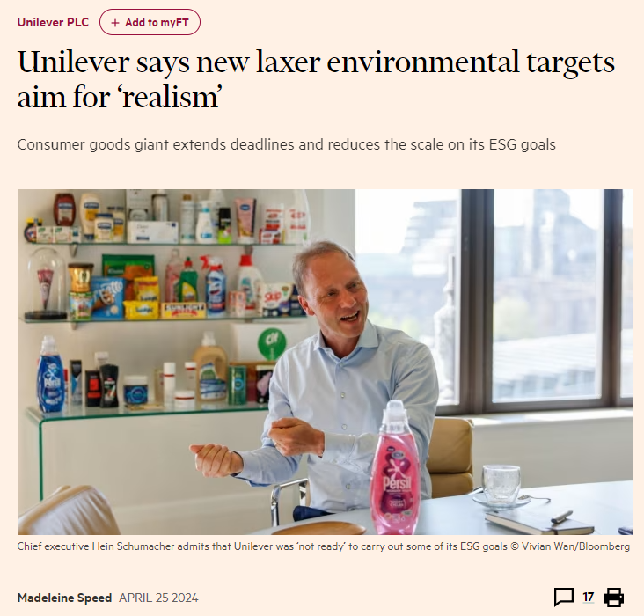
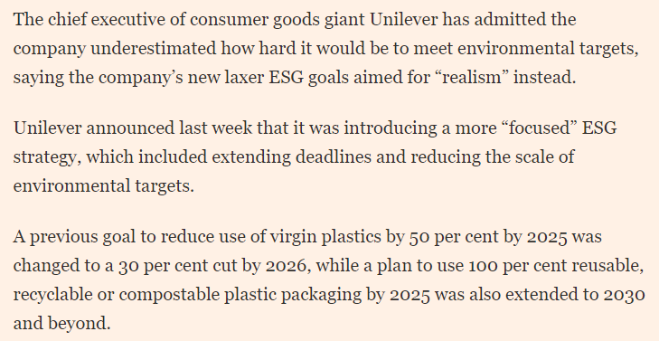
An example-Unilever
https://www.ft.com/content/f5a6b26a-c66c-465d-8751-36b8894d1020
Notes:
依旧是financial导向

Slide 27
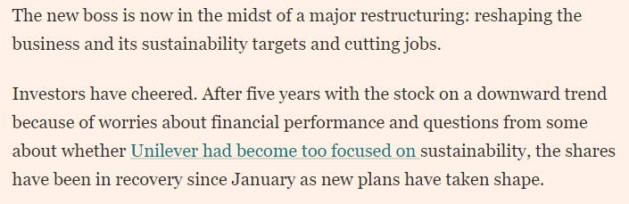
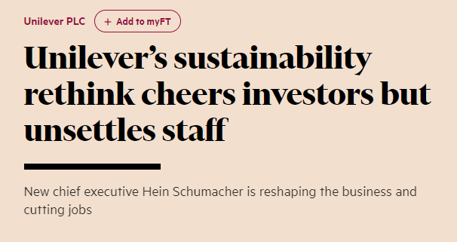
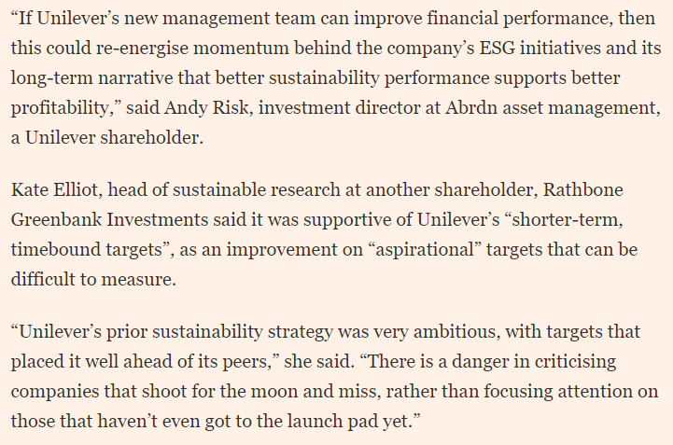
An example-Unilever
https://www.ft.com/content/c4379494-f647-470c-9439-a43abc0f6473
Notes:
依旧是profit导向
Interest无法balance
员工：失望

Slide 28


Strategy – Goals - KPIs
https://www.un.org/sustainabledevelopment/sustainable-development-goals/
169 targets and 232 KPIs

Slide 29
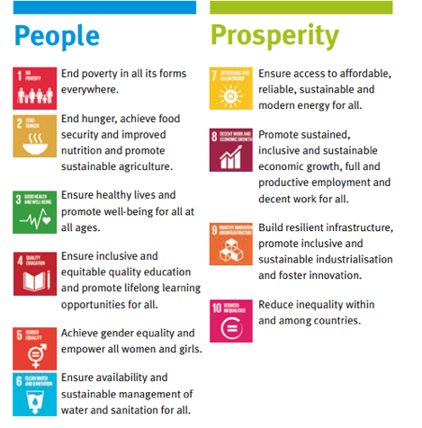

Strategy – Goals - KPIs
Notes:
https://sdgs.un.org/2030agenda

Slide 30

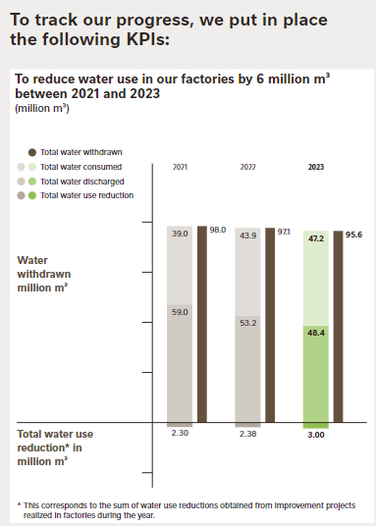


Source: Nestle sustainability report 2023

Slide 31

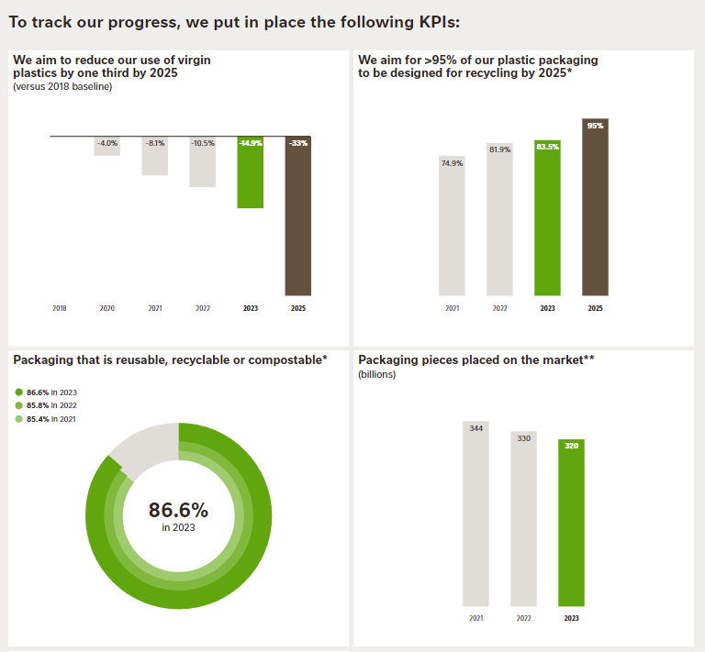


Slide 32
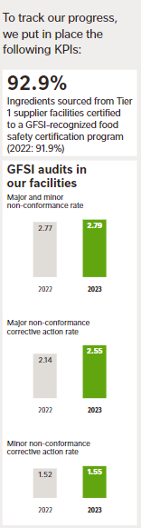



Slide 33
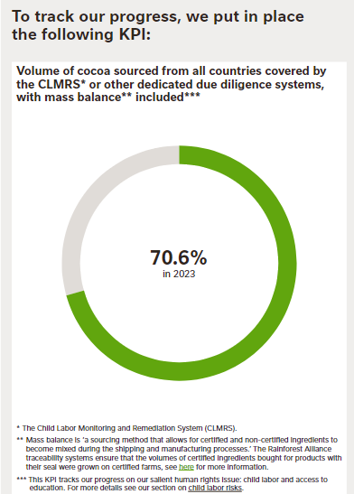

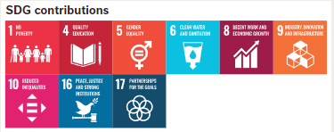

Slide 34

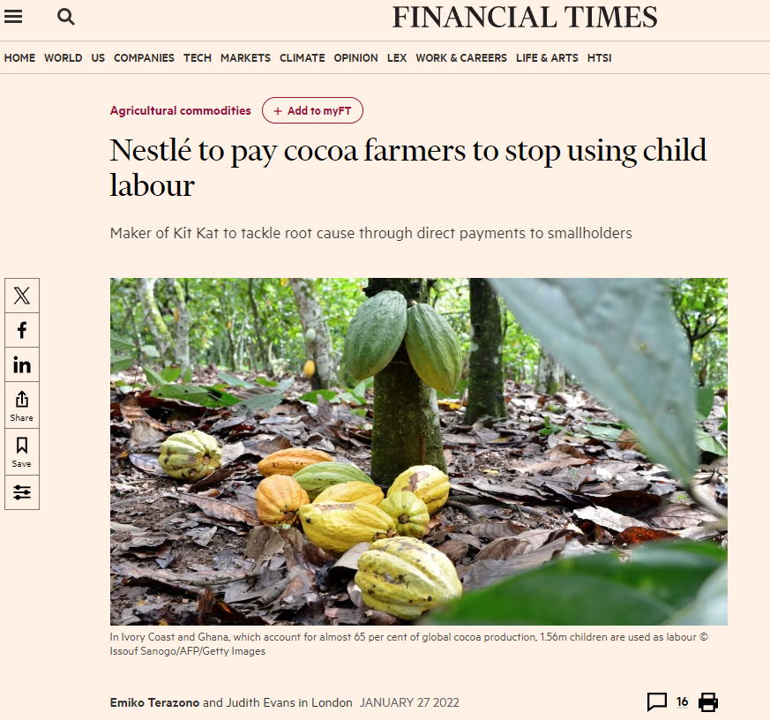

Notes:
朋友购物 即使有improve也很难改变这个印象

Slide 35
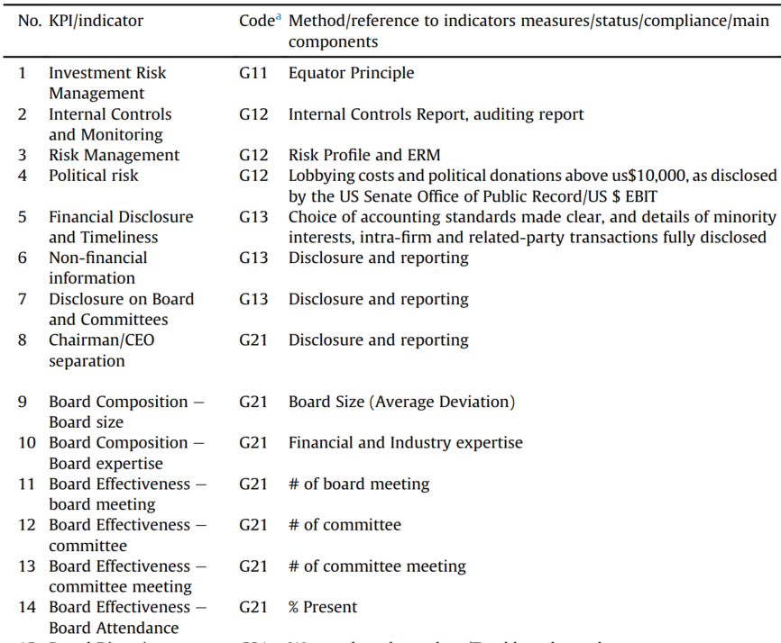
Rahdari and Rostamy (2015)

Slide 36
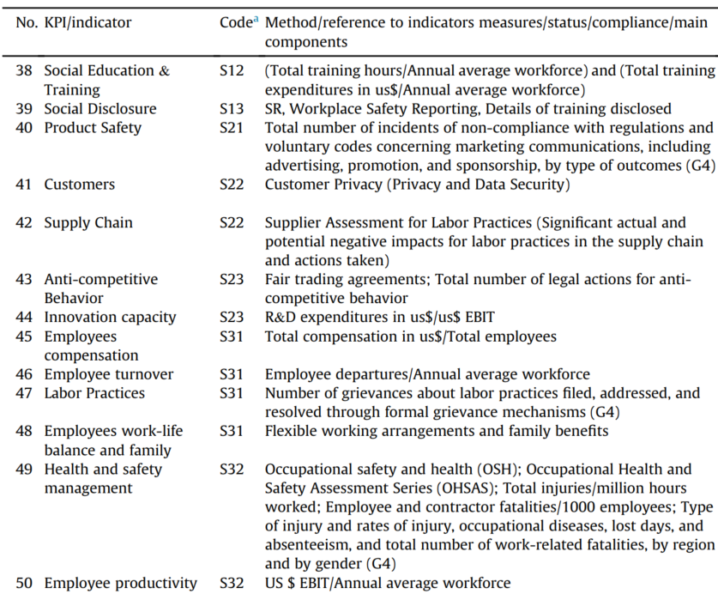
Rahdari and Rostamy (2015)

Slide 37
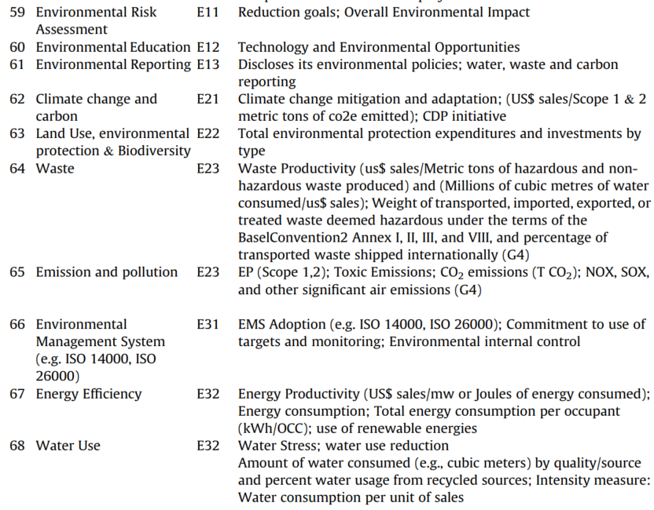
Rahdari and Rostamy (2015)

Slide 38
Balanced ScoreCard
What is a Balanced Scorecard (BSC)?
It is a strategic planning and management system, balancing financial and non-financial goals, indicators and targets.
Organizations use BSCs to:
Communicate and discuss strategy
Align the day-to-day work with strategy
Prioritize projects, products and services
Measure and monitor progress towards strategic targets
Gives a balanced view of performance - holistic system for managing strategy.
Framework used to connect the vision and mission of the organization with its strategic goals, the projects and programs that people are working on and the measurements being used to track success (KPIs).
Notes:
The name “balanced scorecard” comes from the idea of looking at strategic measures in addition to traditional financial measures to get a more “balanced” view of performance.

Slide 39
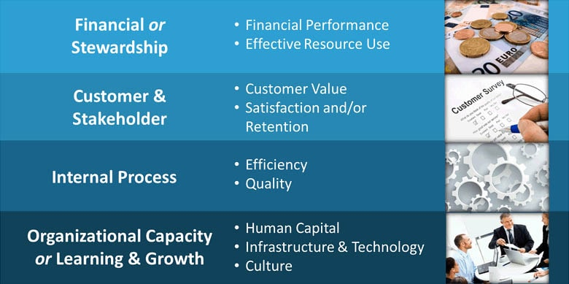
BSC – Perspectives & Strategical Goals

Slide 40
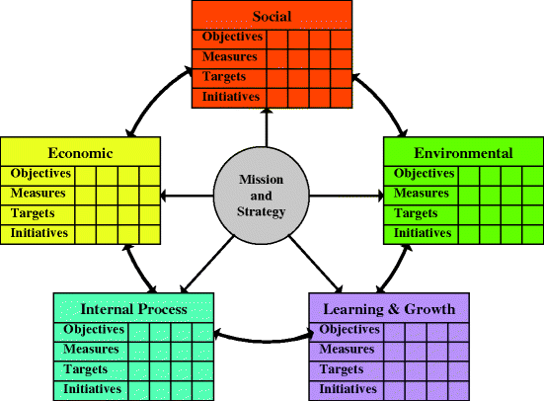
Sustainable Balanced ScoreCard
Some sustainable KPIs:
Environmental perspective:
Resources consumption
Emission to water, natural environment and air
Reuse and recycle rate
Social perspective:
Supplier’s sustainability performance
Job creation
Employee’s benefits
Health and safety performance
Notes:
The Sustainable Balanced Scorecard modifies this model to integrate sustainability into corporate strategy. It adds environmental and social dimensions to the traditional perspectives, allowing organizations to measure and manage their performance in these areas alongside traditional financial and operational metrics. This approach helps companies align their business goals with broader social and environmental objectives.
BSC 提供战略框架，KPI 是具体的衡量指标：
BSC 定义了组织的战略目标和关键成功因素，将战略目标分解为四个维度（财务、客户、内部流程、学习与成长）。
KPI 则是在每个维度下设置的具体衡量标准，用于评估目标的实现情况。例如，在财务视角下，KPI 可能包括“净利润率”、“资产回报率”等。
Benefits of the SBSC:
Holistic performance management: Aligns financial goals with sustainability objectives.
Enhanced stakeholder engagement: Helps communicate performance to a broader audience, including investors, regulators, and customers focused on ESG.
Long-term value creation: Encourages decisions that promote both profitability and sustainability over time.

Slide 41
Group discussion:
Design two KPIs for your group's chosen company
(one quantitative and one qualitative)

Slide 42
ESG investment and principles for responsible investment
42
Notes:
之后会进到investment management company 工作 需要了解

Slide 43
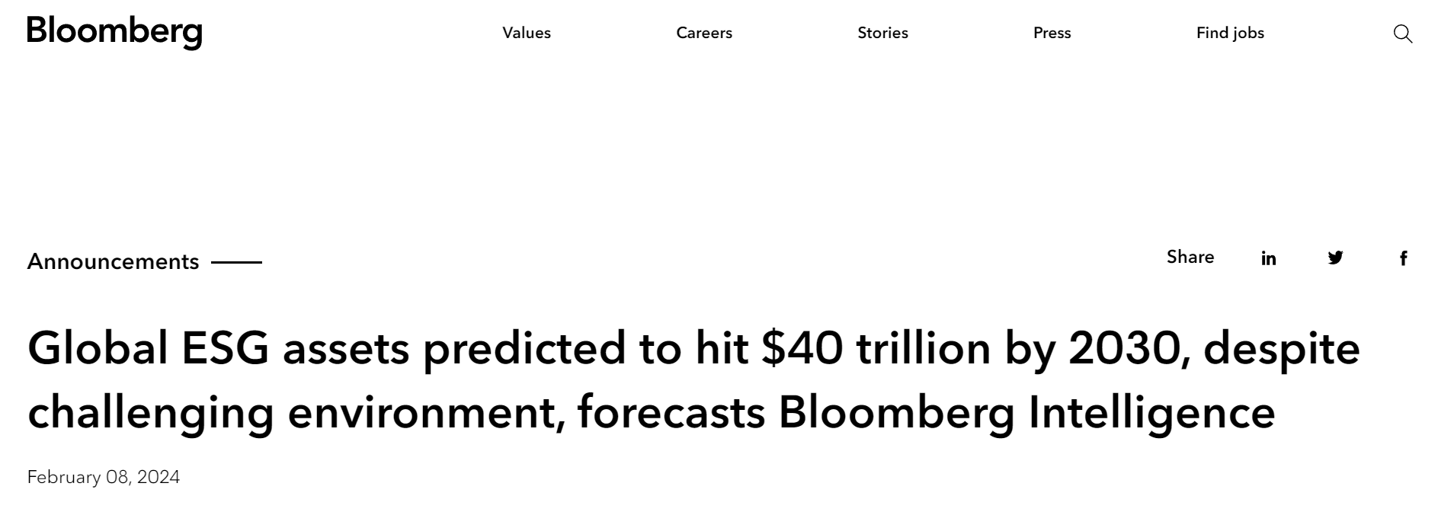
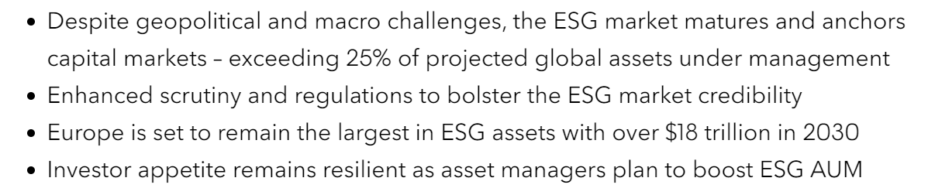

Slide 44
Why ESG investment is becoming increasingly popular?
In addition to financial resources, organisations and their managers have responsibilities for social and environmental resources and impacts.
Managers’ careful consideration of sustainability can be seen as an investment towards the long-term success of the organisation.
Investors try to understand and take into account how sustainability will affect the value and future outlook of the various organisations and other investment targets
Risk and potential returns
Notes:
investors try to understand and take into account how sustainability will affect the value and future outlook of the various organisations and other investment targets. That is, a consideration of how various sustainability issues affect the risk and potential returns associated with an investment. In some cases, sustainability has the potential to bring about a range of opportunities which, for example, could help the organisation grow substantially into new markets or product segments. Green tech companies can be considered here as they may be able to leverage off addressing or responding to environmental issues. For others, however, the consequences of sustainability might be more adverse. An increased risk of regulatory intervention, which would lead to higher costs or, in more extreme cases, even require abandoning the current business model, is a situation that illustrates this point. For example, an organisation might be highly dependent on a particular environmental resource, making its financial outlook highly vulnerable. An obvious instance here would be those companies that rely on fossil fuels. However, as the previous chapters illustrate, it is not only fossil fuel companies that are exposed to the risks associated with sustainability, so such concerns are important more broadly.
Debt: green bonds
In simple terms, a green bond is an instrument used to raise capital for environmental projects. Such projects can be aimed at achieving different types of environmental outcomes, such as environmentally friendly technologies, sustainable agriculture, energy efficiency and mitigation of climate change, to name but a few.
思考：invest到green 但是正是那些高污染的才需要资金去改变

Slide 45

Principles for Responsible Investment
Set of voluntary and aspirational investment principles that offer a menu of possible actions for incorporating ESG issues into investment practice.
The Principles were developed by investors, for investors.
In implementing them, signatories contribute to developing a more sustainable global financial system.
Developed by an international group of institutional investors reflecting the increasing relevance of ESG issues to investment practices.
Notes:
The process was convened by the United Nations Secretary-General.
The Principles for Responsible Investment (PRI) is based on a set of voluntary investment principles concerning how ESG issues can be included in investment practices. Founded in 2006, the aspirational goal behind the Principles is the development of a more sustainable global financial system. The Principles, originally developed by the investor community, have been signed by a broad range of major professional asset owners, financial service providers and investment managers.
PRI seeks to advance responsible investment and sustainable markets in various ways. They engage in policy work with global policymakers, they develop tools for investors who seek to incorporate ESG factors into their decisions, and they engage in the development and publishing of data and knowledge on responsible investments, ESG and the sustainability of global financial markets. In addition to collaborating with policymakers and the investment community, the PRI also engages with academics in seeking to create more scientific research on responsible investment and sustainable financial markets, and to stimulate interaction between academics, policymakers and the investment community.

Slide 46
Principles for Responsible Investment
There is a need to align investors with broader objectives of society because ESG issues can affect the performance of investment portfolios.
What are the Principles for Responsible Investment? | PRI Web Page | PRI (unpri.org)
Principle 1: We will incorporate ESG issues into investment analysis and decision-making processes.
Principle 2: We will be active owners and incorporate ESG issues into our ownership policies and practices.
Principle 3: We will seek appropriate disclosure on ESG issues by the entities in which we invest.
Principle 4: We will promote acceptance and implementation of the Principles within the investment industry.
Principle 5: We will work together to enhance our effectiveness in implementing the Principles.
Principle 6: We will each report on our activities and progress towards implementing the Principles.
Signatory directory | PRI (unpri.org)
Notes:
Principle 1: We will incorporate ESG issues into investment analysis and decision-making processes.
Principle 2: We will be active owners and incorporate ESG issues into our ownership policies and practices.
Principle 3: We will seek appropriate disclosure on ESG issues by the entities in which we invest.
Principle 4: We will promote acceptance and implementation of the Principles within the investment industry.
Principle 5: We will work together to enhance our effectiveness in implementing the Principles.
Principle 6: We will each report on our activities and progress towards implementing the Principles.
Principle 1: We will incorporate ESG issues into investment analysis and decision-making processes.
Possible actions:
Address ESG issues in investment policy statements.
Support development of ESG-related tools, metrics, and analyses.
Assess the capabilities of internal investment managers to incorporate ESG issues.
Assess the capabilities of external investment managers to incorporate ESG issues.
Ask investment service providers (such as financial analysts, consultants, brokers, research firms, or rating companies) to integrate ESG factors into evolving research and analysis.
Encourage academic and other research on this theme.
Advocate ESG training for investment professionals.
Learn how the PRI can support signatories implement Principle 1
Principle 2: We will be active owners and incorporate ESG issues into our ownership policies and practices.
Possible actions:
Develop and disclose an active ownership policy consistent with the Principles.
Exercise voting rights or monitor compliance with voting policy (if outsourced).
Develop an engagement capability (either directly or through outsourcing).
Participate in the development of policy, regulation, and standard setting (such as promoting and protecting shareholder rights).
File shareholder resolutions consistent with long-term ESG considerations.
Engage with companies on ESG issues.
Participate in collaborative engagement initiatives.
Ask investment managers to undertake and report on ESG-related engagement.
Principle 3: We will seek appropriate disclosure on ESG issues by the entities in which we invest.
Possible actions:
Ask for standardised reporting on ESG issues (using tools such as the Global Reporting Initiative).
Ask for ESG issues to be integrated within annual financial reports.
Ask for information from companies regarding adoption of/adherence to relevant norms, standards, codes of conduct or international initiatives (such as the UN Global Compact).
Support shareholder initiatives and resolutions promoting ESG disclosure.
Principle 4: We will promote acceptance and implementation of the Principles within the investment industry.
Possible actions:
Include Principles-related requirements in requests for proposals (RFPs).
Align investment mandates, monitoring procedures, performance indicators and incentive structures accordingly (for example, ensure investment management processes reflect long-term time horizons when appropriate).
Communicate ESG expectations to investment service providers.
Revisit relationships with service providers that fail to meet ESG expectations.
Support the development of tools for benchmarking ESG integration.
Support regulatory or policy developments that enable implementation of the Principles.
Principle 5: We will work together to enhance our effectiveness in implementing the Principles.
Possible actions:
Support/participate in networks and information platforms to share tools, pool resources, and make use of investor reporting as a source of learning.
Collectively address relevant emerging issues.
Develop or support appropriate collaborative initiatives.
Principle 6: We will each report on our activities and progress towards implementing the Principles.
Possible actions:
Disclose how ESG issues are integrated within investment practices.
Disclose active ownership activities (voting, engagement, and/or policy dialogue).
Disclose what is required from service providers in relation to the Principles.
Communicate with beneficiaries about ESG issues and the Principles.
Report on progress and/or achievements relating to the Principles using a comply-or-explain approach.
Seek to determine the impact of the Principles.
Make use of reporting to raise awareness among a broader group of stakeholders

Slide 47
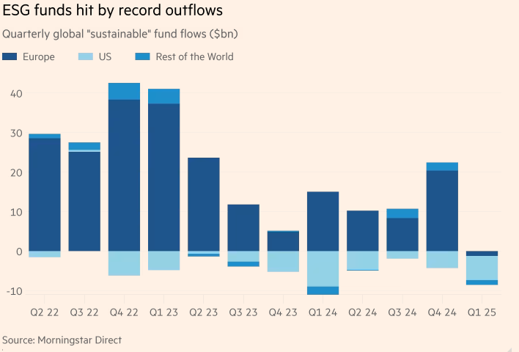
Backlash Against ESG Investment
Notes:
最后会考虑是否能够incorporate in underlying value of the firm
https://www.ft.com/content/9f425c25-4fc3-45de-bcc5-e9c75d6d14d3
是否能带来经济上的return-costly
是否真的帮助改善E S G-greenwashing
依赖rating-reliable？

Slide 48
ESG-scores, ratings and ranking lists
48
Notes:
Investment decision也会基于这个

Slide 49
ESG-scores, ratings and ranking lists
ESG rating schemes aim to help those interested in taking sustainability into account in their decision-making in the financial markets.
Different types:
Label: if an investment target, be that an organisation or a bond, fulfils particular criteria, it receives a label signalling it
Stock market indexes (Dow Jones Sustainability World Index and the FTSE4Good). These indexes include an annually updated list of companies which have been selected on the basis of varying sustainability criteria. Many companies consider these indexes to be important and are keen to highlight their membership as a signal of their commitment and achievements in sustainability
Various ranking lists which are based on more complicated scoring systems of organisational activities (CDP’s A-list, Global Knights 100 listing)
Notes:
The complexity inherent in the assessment and evaluation of sustainability factors has paved the way for the emergence of different types of aggregated metrics and rating schemes. These metrics and rating schemes aim to help those interested in taking sustainability into account in their decision-making in the financial markets. Some of these resemble labels one can see in a supermarket: if an investment target, be that an organisation or a bond, fulfils particular criteria, it receives a label signalling it. At the simplest, this could entail for instance an NGO including a company on a list of signatories committed to protecting some type of wildlife in its investments, or alternatively on a negative list of companies, which have not publicly committed to reducing their emissions according to the most recent climate accord.
Other powerful examples would be stock market indexes such as the Dow Jones Sustainability World Index and the FTSE4Good. Both of these indexes include an annually updated list of companies which have been selected on the basis of varying sustainability criteria. Many companies consider these indexes to be important and are keen to highlight their membership as a signal of their commitment and achievements in sustainability (see the below “Focus on practice” for more details).
On a more advanced level, there are various ranking lists which are based on more complicated scoring systems of organisational activities. Examples of these include CDP’s A-list, focusing on corporate transparency and climate action, and Global Knights 100 listing what they label the most sustainable companies in the world. Likewise, scores and ratings are available via prominent financial media companies, such as Thomson Reuters and Bloomberg, major finance companies, such as MSCI, as well as specialised companies, such as Sustainalytics. In some of the rating schemes companies are given exact scores, while in other cases rankings are handed out in tiers. Oftentimes, however, the exact mechanism used to produce the scores is not presented publicly or is only vaguely discussed, even when the rating provider publicly claims to be committed to high transparency. In other words, those seeking to use the information have limited capability to evaluate how the scores have been put together and which items have been given emphasis.

Slide 50
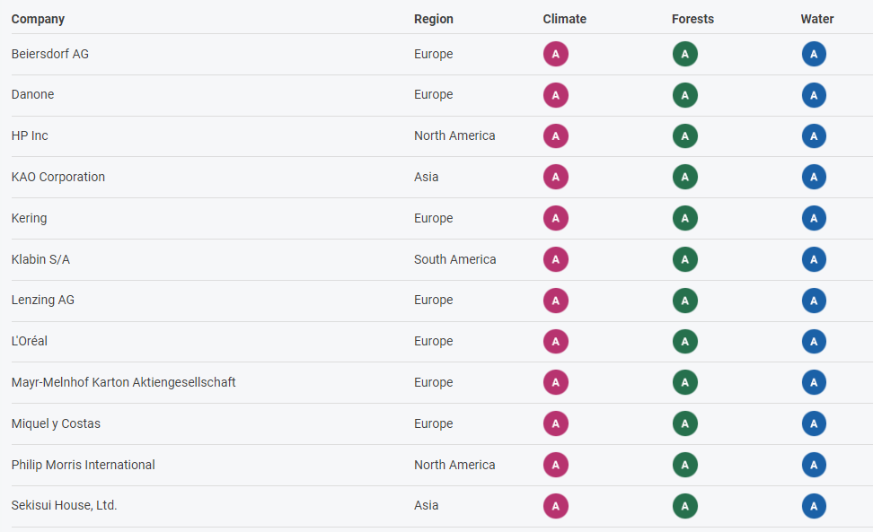

ESG-scores, ratings and ranking lists
Global Knights 100 listing: https://www.corporateknights.com/rankings/global-100-rankings/2024-global-100-rankings/the-20th-annual-global-100/
Notes:
Global Knights 100 listing including environmental and social

Slide 51
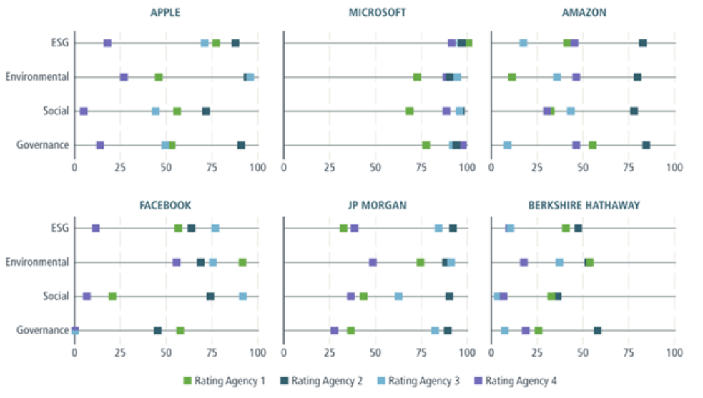
Sustainability rankings

Slide 52
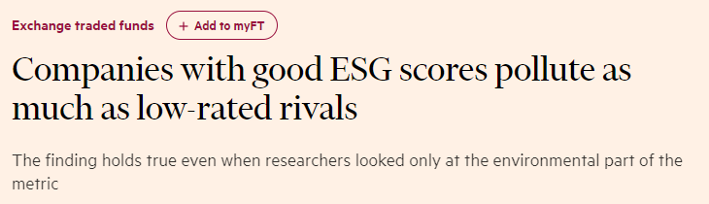
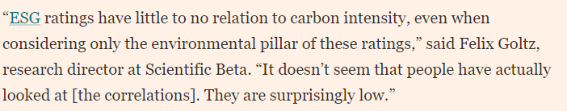
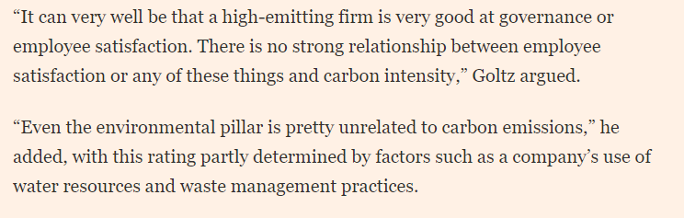
Challenges of ESG rating
https://www.ft.com/content/b9582d62-cc6f-4b76-b0f9-5b37cf15dce4#:~:text=Companies%20rated%20highly%20on%20widely%20accepted%20environmental,%20social%20and%20governance

Slide 53
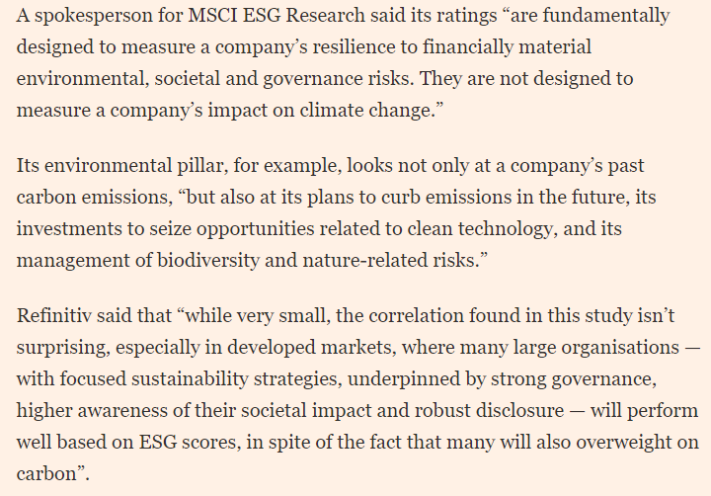
Challenges of ESG rating
https://www.ft.com/content/b9582d62-cc6f-4b76-b0f9-5b37cf15dce4#:~:text=Companies%20rated%20highly%20on%20widely%20accepted%20environmental,%20social%20and%20governance

Slide 54
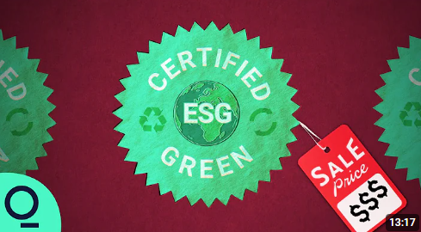
Challenges of ESG rating
https://www.youtube.com/watch?v=f_rrS-_giP8
Notes:
3.30-7.30
MSCI macdonal’s

Slide 55
Challenges of ESG rating
Unclear evaluation criteria: the exact mechanism used to produce the scores is not presented publicly or is only vaguely discussed, even when the rating provider publicly claims to be committed to high transparency
Such rating schemes can be highly influential in societies (Chelli and Gendron, 2013)
Unobjective
ESG rating disagreement
May lead to the opposite of what was intended
Notes:
Example: RKS data 有关ESG reporting quality的，CEO都不知道criteria怎么算的 （credibility？）
Such rating schemes can be highly influential in societies (Chelli and Gendron, 2013). Explored from the perspective of media coverage and societal discussion, leading companies can receive praise and good publicity due to their commitment to sustainability, and thereby come to set a benchmark for others regarding what it means to be a leading company. Again, such examples can be seen in a positive light, as they can stimulate others to compete and improve. However they can also be interpreted more pessimistically as some of these praised examples fall far from what is required for a sufficient transition to sustainability.
Unobjective: 如果买了咨询服务，会提高rank

Slide 56
Challenges of ESG rating
The role of ESG reporting?
Greater ESG disclosure actually leads to greater ESG rating disagreement (Christensen et al., 2022)

Slide 57
Conclusion:
Sustainability reporting assurance
ESG KPIs
ESG investment and principles for responsible investment
ESG-scores, ratings and ranking lists
57

